Slide 1
Coordinate-based Texture Inpainting for Pose-Guided Image Generation
arXiv 1811.11459
Artur Grigorev, Artem Sevastopolsky,
Alexander Vakhitov, Victor Lempitsky
Samsung AI Center, Moscow
Skolkovo Institute of Science and Technology (Skoltech)
梁天保
https://arxiv.org/abs/1811.11459

Slide 2
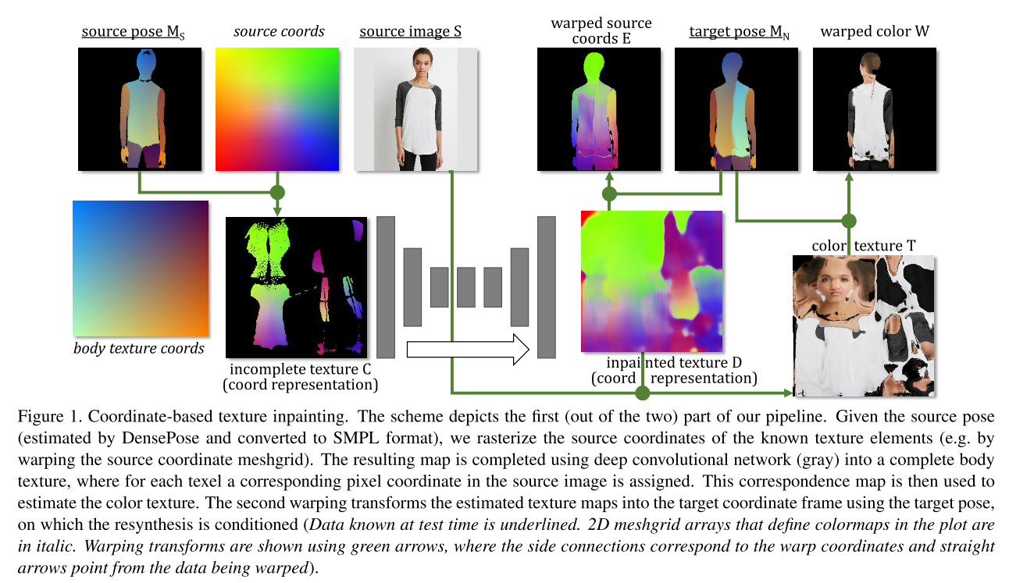
Abstract
https://arxiv.org/abs/1811.11459

Slide 3
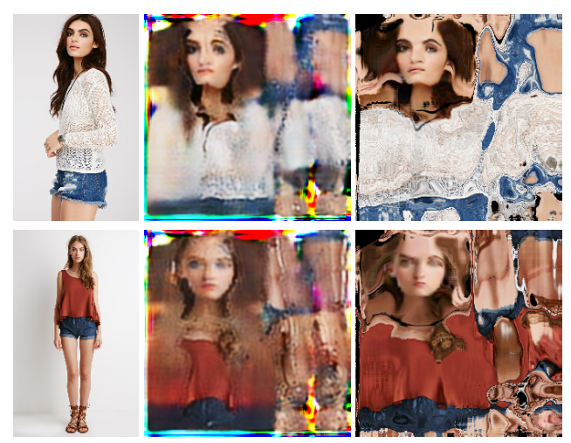
Abstract
https://arxiv.org/abs/1811.11459

Slide 4
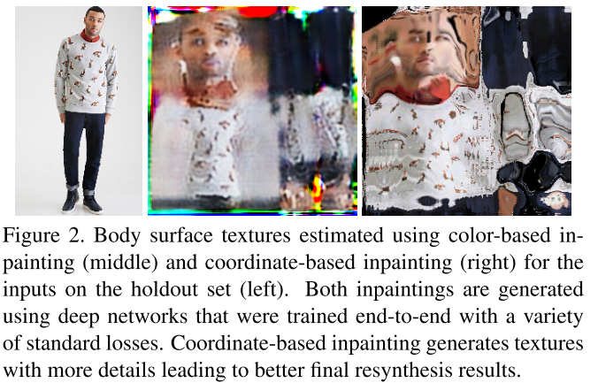
Abstract
https://arxiv.org/abs/1811.11459

Slide 5
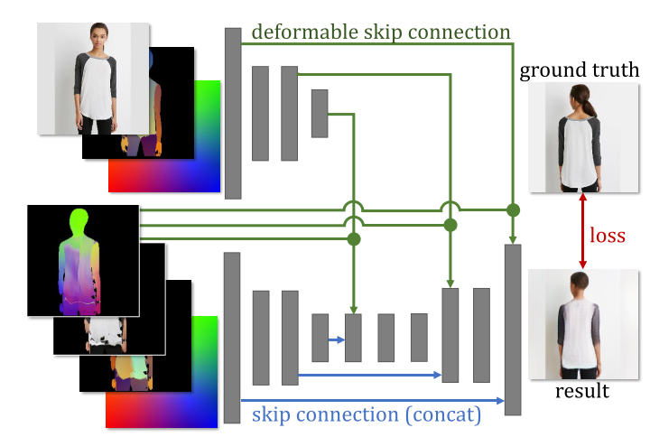
Abstract
https://arxiv.org/abs/1811.11459

Slide 6
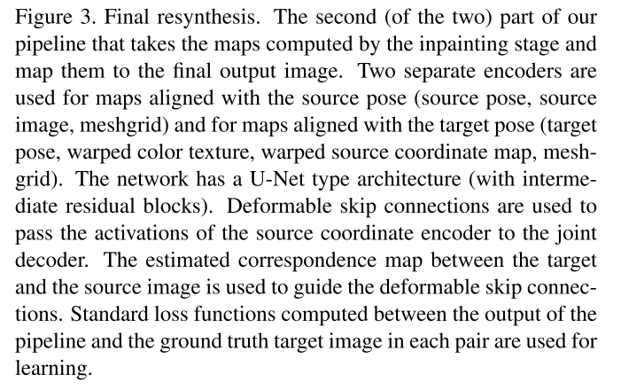
Abstract
https://arxiv.org/abs/1811.11459

Slide 7
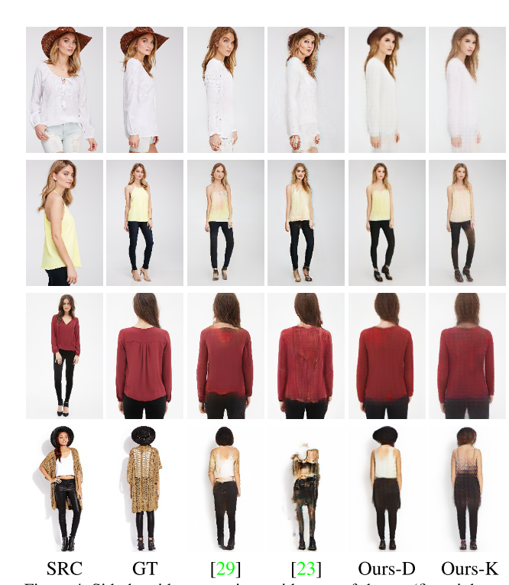
Abstract
https://arxiv.org/abs/1811.11459

Slide 8
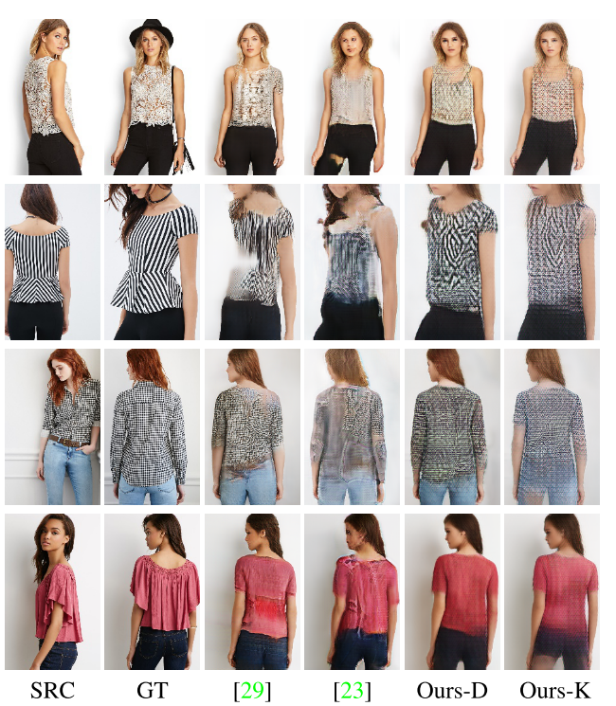
Abstract
https://arxiv.org/abs/1811.11459

Slide 9
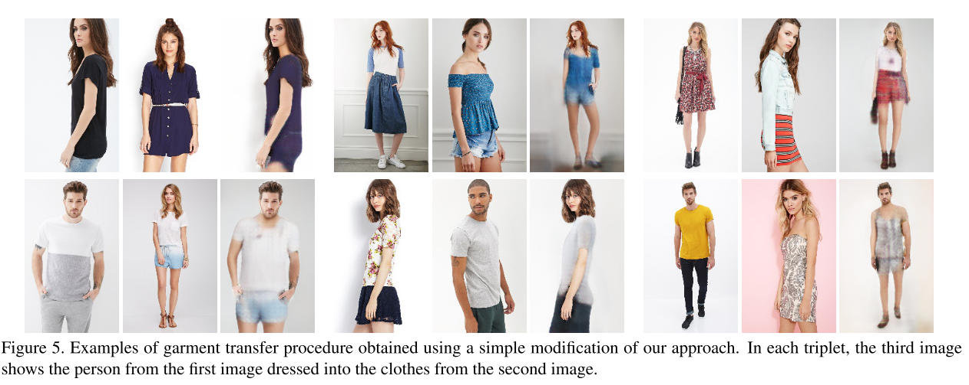
Abstract
https://arxiv.org/abs/1811.11459

Slide 10
Thanks
https://arxiv.org/abs/1811.11459

